Slide 1



Deformation analysis of advanced materials using digital holography
Olivia Thomas
Dr. Christopher Mann, Mentor
Northern Arizona University

Slide 2
My Interests
Use digital and polarization holography techniques
Observe microscopic deformation and crazing in materials
Specifically, observe the polarization state at the surface of poly methyl methacrylate (PMMA).
Also known as Plexiglas.
Notes:
I am interested in using digital and polarization holography techniques to observe microscopic deformations in materials. I am particularly interested in observing a specific type of deformation called crazing in poly methyl methacrylate, abbreviated PMMA. PMMA is also known as Plexiglas.

Slide 3
Crazing
Plastics and glass undergo crazing
Hair-fine strains due to pressure and temperature changes in the environment
Example: airplane windows
Notes:
Many materials undergo crazing including plastics and glasses. Crazing is a type of deformation where a material forms hair-fine strains due to pressure and temperature changes in the environment. The details of crazing are difficult to see with the human eye, but will be observable with this experiment. I am focusing on crazing in PMMA in particular because PMMA is used in many technical and industrial fields and crazing diminishes the effectiveness of PMMA.
One example of crazing occurs in old airplane windows.

Slide 4
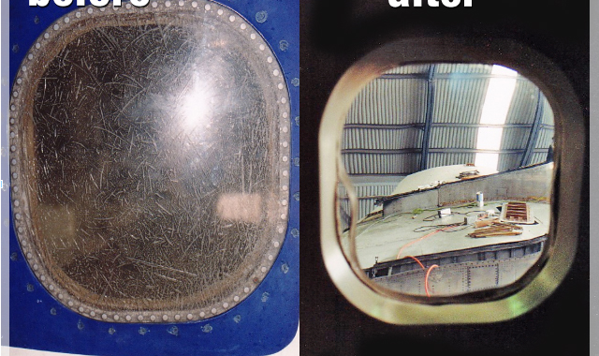
An airplane window after crazing
Notes:
We can see the structure of the larger scratches with our eyes, but the fogginess of the Plexiglas airplane window is caused by crazing. Here you can see a window affected by crazing and a new one that has not yet undergone crazing. The visibility through the window on the left is severely affected by crazing. This experiment will allow us to observe the details of how crazing forms in materials such as PMMA and possibly find patterns in the formation of this particular type of deformation.

Slide 5
Digital Holography
Obtain and process holograms digitally, with a CCD (Charge Coupled Device)
Used to measure optical phase data at the surface of a specimen
Results in a 3D image of the specimen
Incorporate polarized light to obtain polarization state at surface of specimen.
Notes:
I want to observe this deformation by implementing both digital and polarization holography techniques. Digital holography is the practice of obtaining and processing holograms digitally, with a charge coupled device, or CCD for short. Digital holography is used for measuring the optical phase data at the surface of a specimen. Numerical and computational reconstruction of this data results in a three dimensional digital image of the sample and gives insight to the surface structure of the sample. I incorporated polarized light into this experiment to also obtain the polarization state at the surface of the specimen.

Slide 6
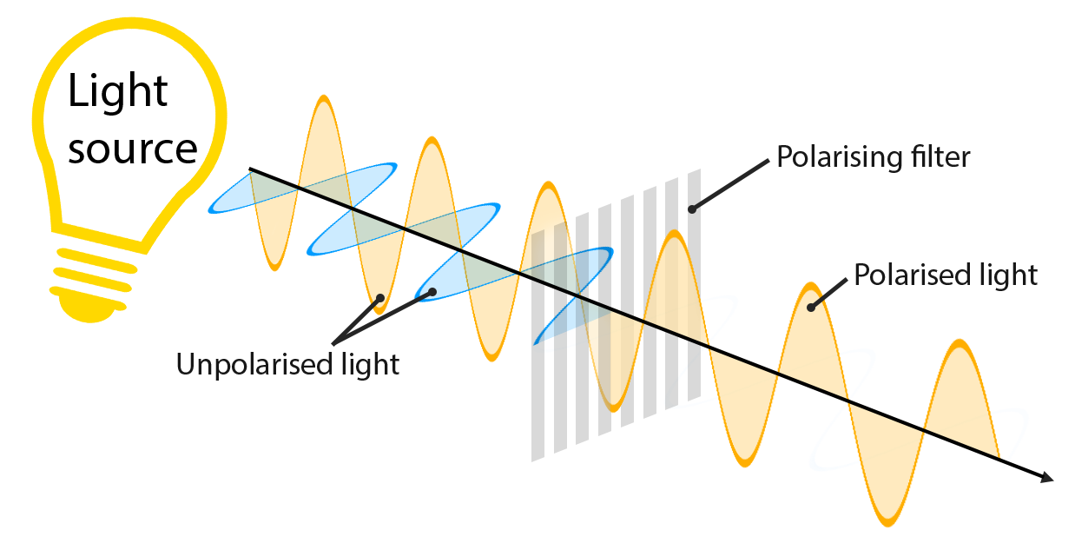
Polarization
Polarization is the orientation of the electric field.
Notes:
Polarization is defined as the orientation of the electric field of the light. In this figure, un-polarized light travels through a polarizing filter or polarizer and becomes linearly polarized. If the polarizer is rotated, it will change the polarization of the light.

Slide 7
Polarization
Light with perpendicular polarizations do not interfere with each other
Light with a polarization angle 0 < θ < 90 degrees will interfere with both 0 degree polarized light and 90 degree polarized light
Notes:
Other important characteristics of polarized light that pertain to my experiment are that light with perpendicular polarizations do not interfere with each other, but light with a polarization of some angle between 0 and 90 degrees will interfere with both perpendicular polarizations.

Slide 8
Define Investigation
I constructed a digital holography setup that implements an object beam and two reference beams with perpendicular polarizations.
A microscope objective lens was added to the setup to be able to see microscopic deformation.
Notes:
I constructed a digital holography setup that implements an object beam and two reference beams with perpendicular polarizations. I also added a microscope objective to the setup to be able to see the microscopic deformation I described earlier. Currently, crazing is imaged with high quality digital cameras, but these methods lack the ability to show the actual depth of the scratches and produce only two dimensional images. This technique will be superior in observing crazing because it will be used to produce three dimensional images of the microscopic scratches and allow for measurements of actual depths of the scratches.

Slide 9
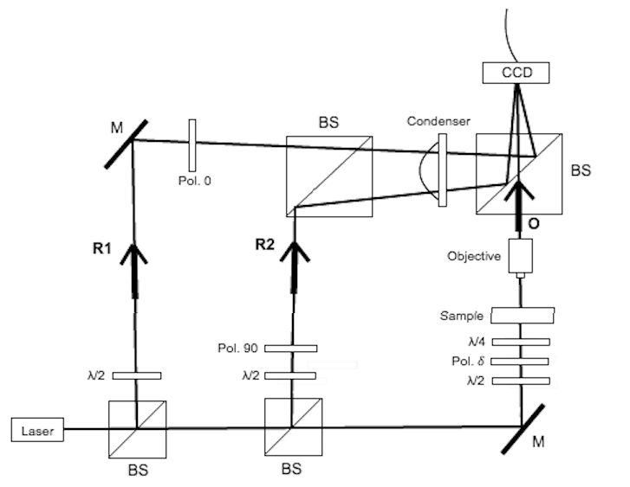
Experimental Setup
Notes:
Here is a diagram of the experimental setup I built. The laser is a fiber optic collimator specially designed to maintain polarization and has a wavelength of 635 nm. It is split into three separate beams by two beam splitters. The first two beams, R1 and R2 are the reference beams. R1 has a polarization of 0 degrees and R2 has a polarization of 90 degrees. The two reference beams travel to the CCD as shown. The third beam is the object beam. The light travels through an adjustable polarizer, whose angles vary between 0 and 90 degrees. The object beam then travels through the sample and then through the objective to magnify the sample, and to the CCD.

Slide 10
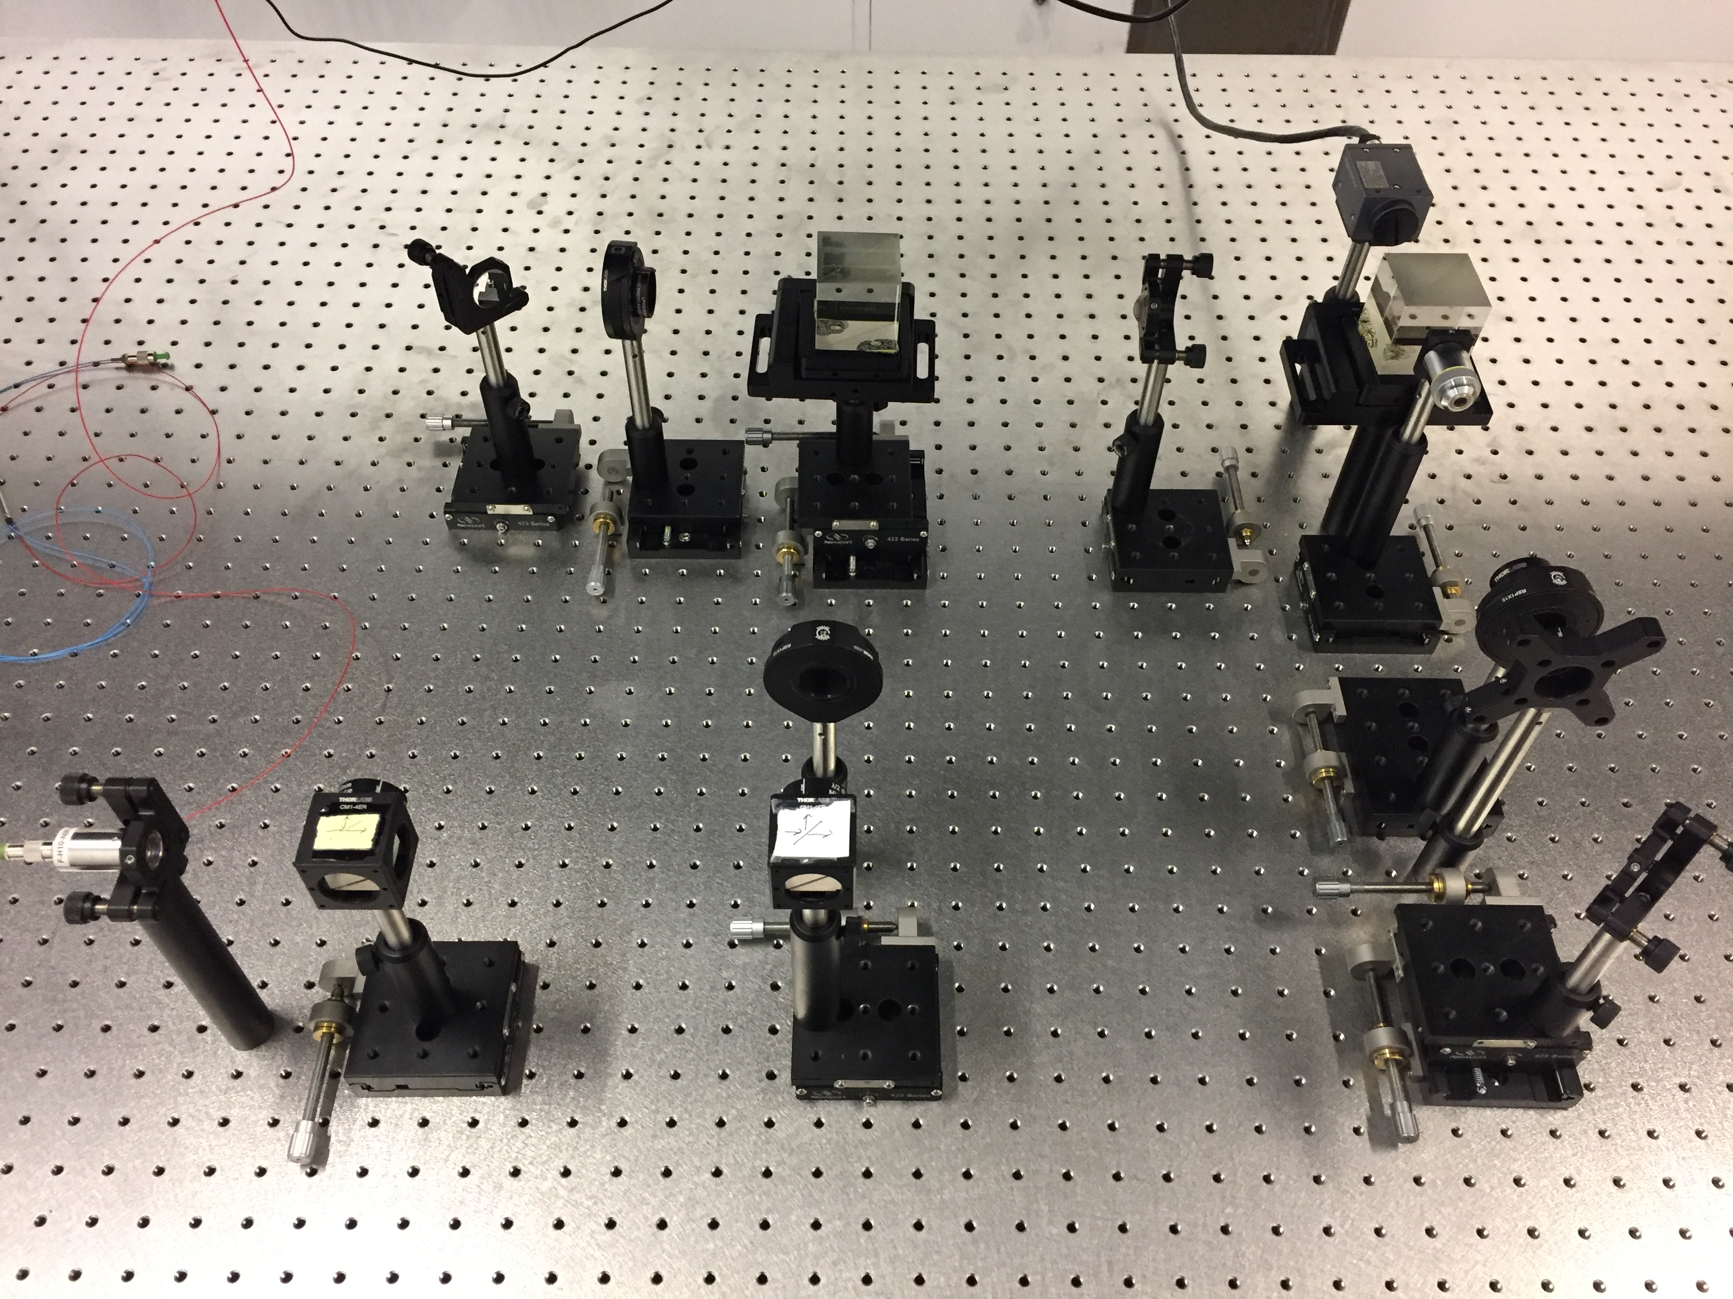
Experimental Setup
Notes:
Using this setup, I will image PMMA and use the analysis of the polarization state at the surface of the specimen to determine possible deformations in the sample. This setup is unique because it has the ability to analyze both phase data and polarization state at the surface of the specimen, so to obtain a full understanding of surface structure of the PMMA

Slide 11
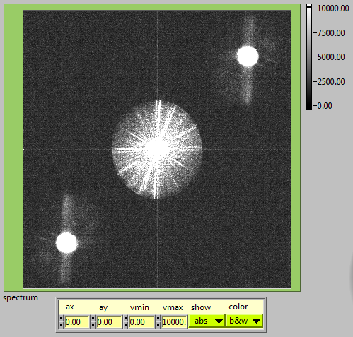
Fourier Space
Notes:
This is an image of the Fourier Space of the object beam and reference beam 2. Bright spots indicate strong interference between the two beams. When the first reference beam is adjusted so to interfere correctly with the object beam, two more bright spots will be accessible in the first and third quadrant. We used numerical techniques to reconstruct the hologram from the phase information contained in these bright spots.

Slide 12
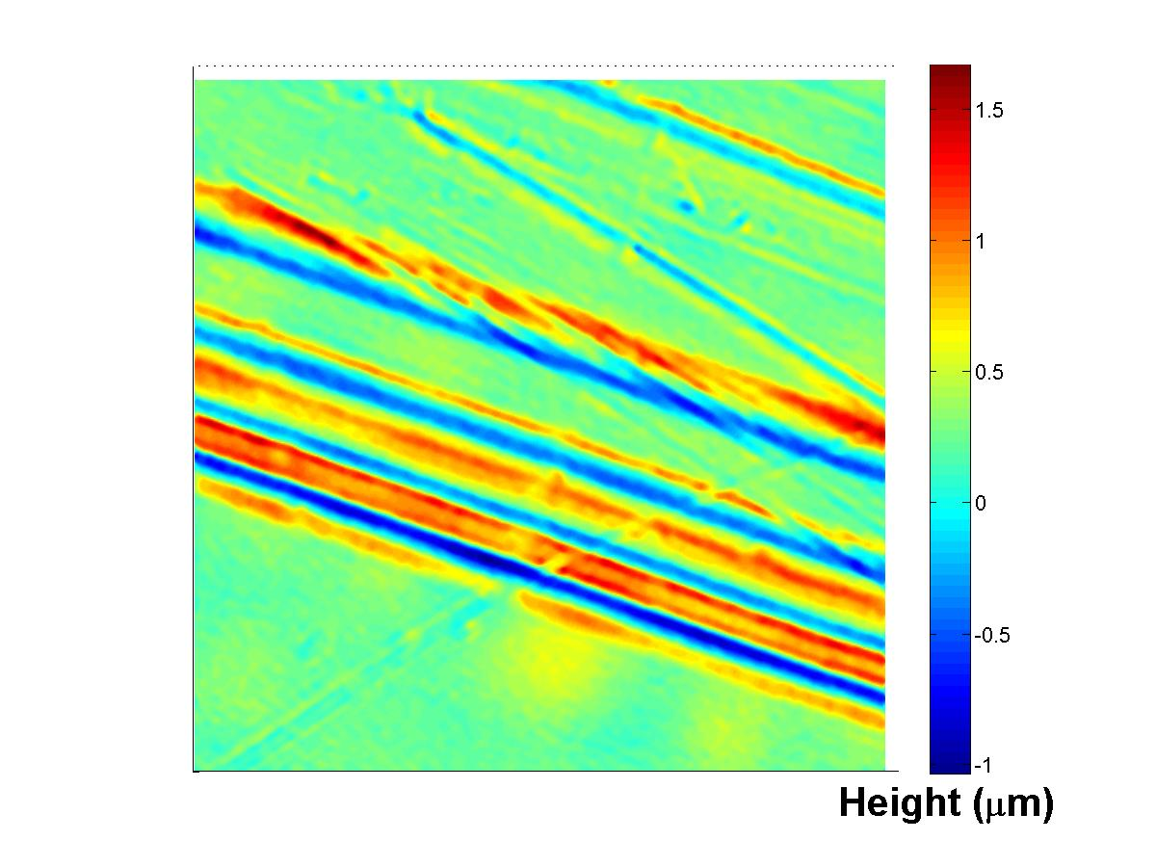
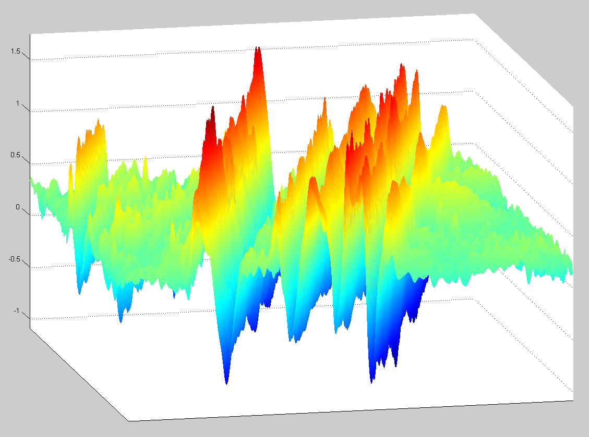
Analysis of PMMA
Notes:
From the current Fourier Space, we were able to reconstruct the hologram to produce three dimensional images of the sample. Here is a topographic image of the PMMA sample with scratches in it. The scratches are about 1 micron deep. Here is the 3D image of the same sample. This technique clearly shows the depth of the scratches and the peaks that arose next to the scratches.

Slide 13
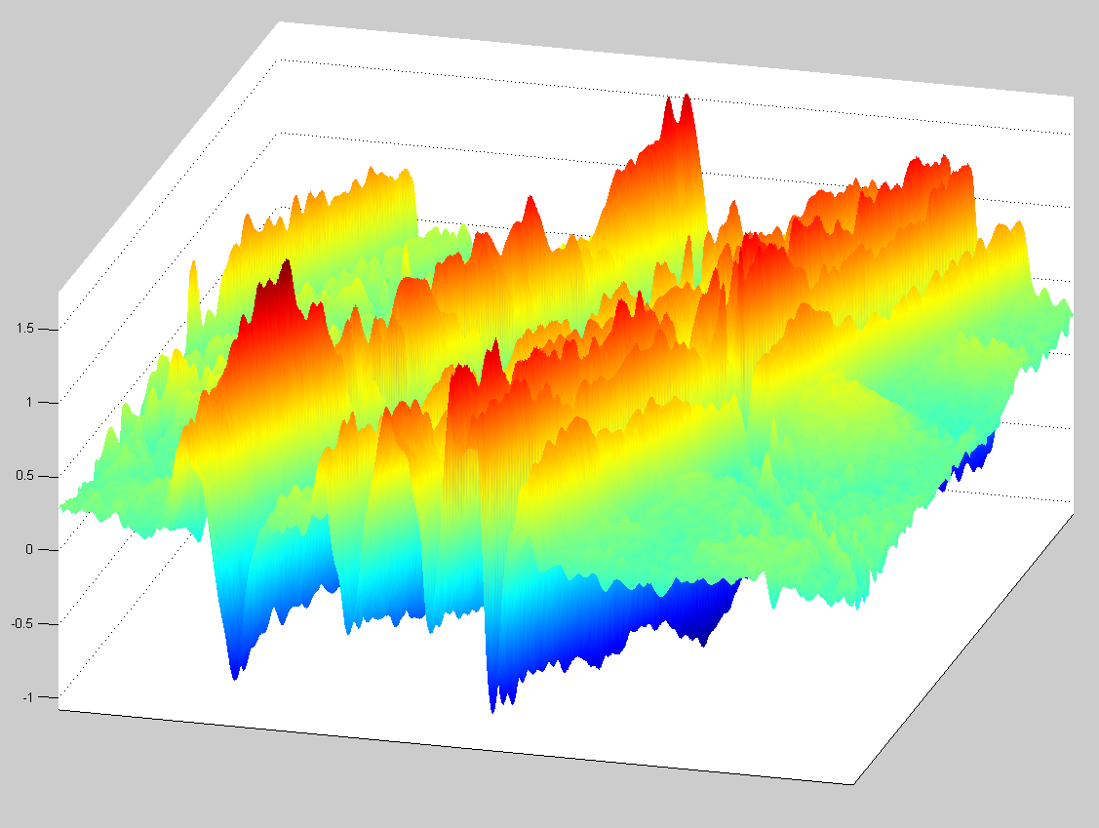
3D Images of PMMA
Notes:
The same sample from a different angle.

Slide 14
Future Work
Reconstruction of both reference beams and object beam
Analysis of polarization state
Continuing this summer!
Notes:
I have not yet reconstructed the first reference wave or analyzed the polarization state using this setup, but both are goals of mine are to be completed over the summer. I believe this technique will be extremely useful in imaging the surface of deformed materials and could be used as a way to test the quality of materials such as PMMA.

Slide 15
Acknowledgements
I would like to thank Dr. Christopher Mann for his mentorship throughout this project, Ben Thiesing for his advice and assistance, Kathleen Stigmon and Nadine Barlow for their support, and the NAU NASA Space Grant for funding this research.

